Slide 1
Introduction to GIS
Matt Quick
October 19, 2016

Slide 2
What does GIS do?
1) Provides a database framework to integrate spatial and non-spatial data

Slide 3
What does GIS do?
1) Provides a database framework to integrate spatial and non-spatial data
2) Mapping and visualization

Slide 4
What does GIS do?
1) Provides a database framework to integrate spatial and non-spatial data
2) Mapping and visualization
3) Analysis

Slide 5
GIS Software
ArcGIS
• Most popular
• Online and desktop versions
• Probably use this in professional
contexts
Quantum GIS
• Free and open source
• Robust user community

Slide 6
Map Projections
Earth is an oblate spheriod.
Computer screens and maps are flat.
Map projections represent spheriods on flat surface. However, often a trade-off between distance, direction, and area.

Slide 7
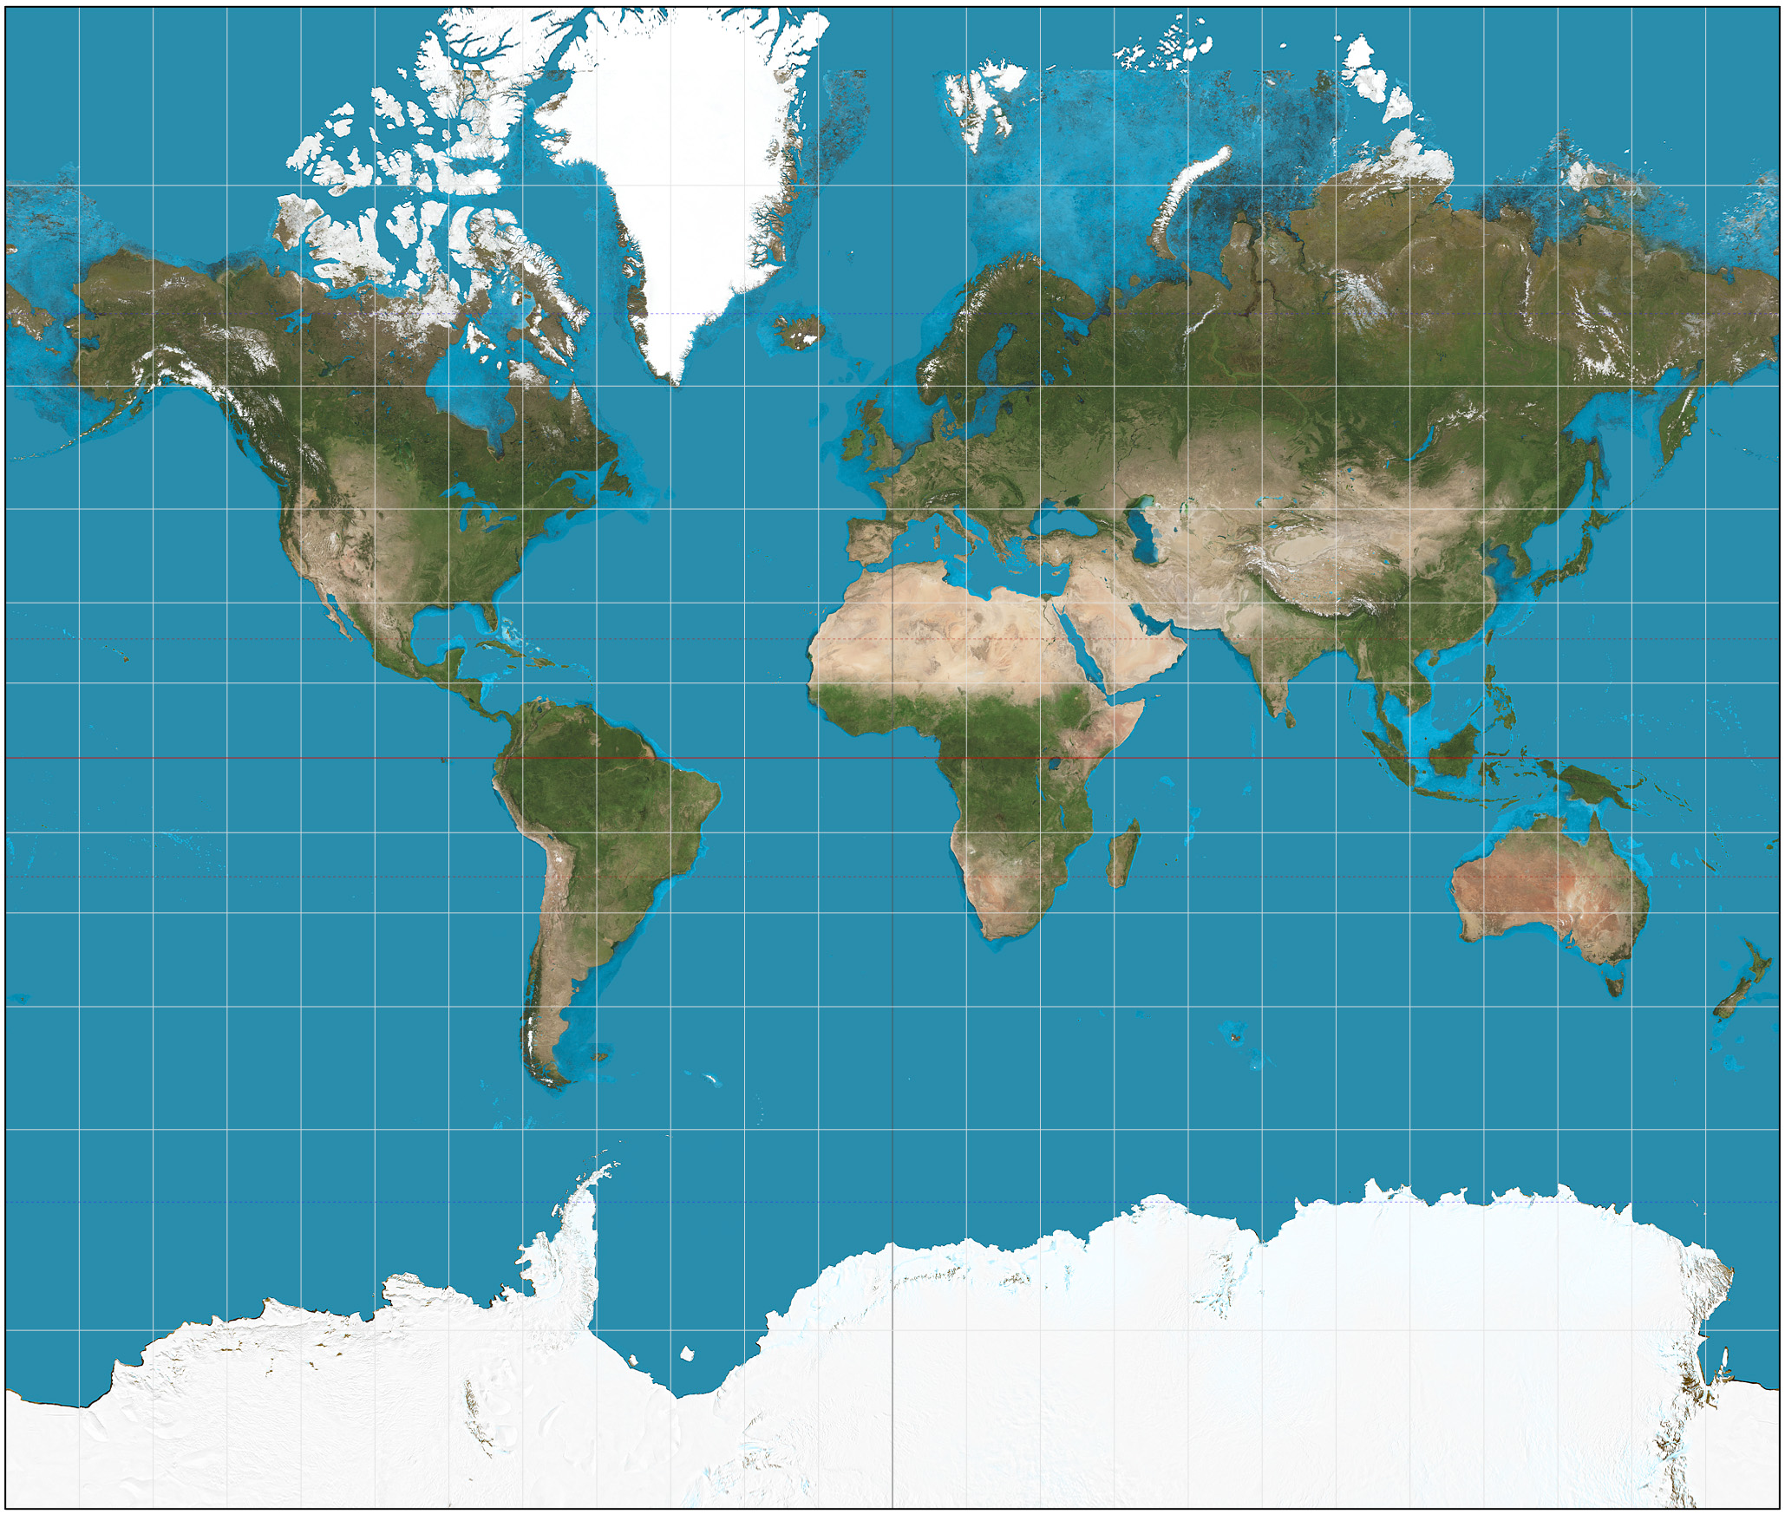

Slide 8
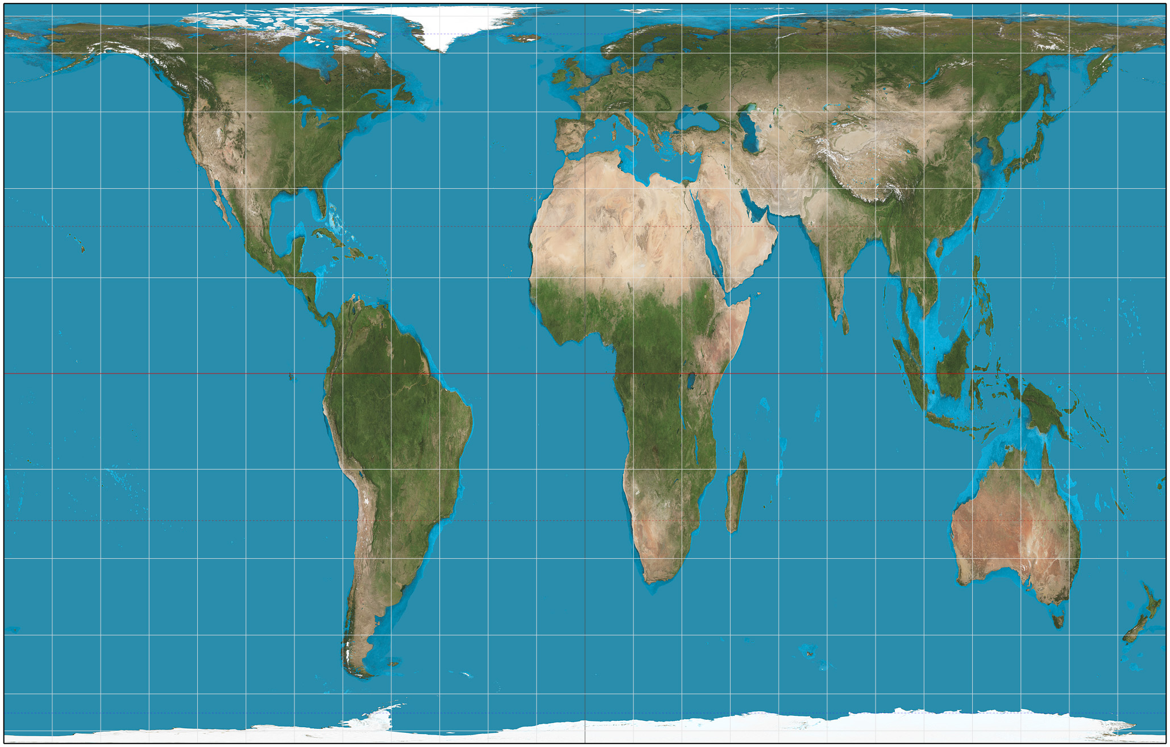
Notes:
http://spatialreference.org/

Slide 9
Spatial Data Types
Raster
• Grid cells (rows, columns)
• Each cell contains data
Example: Satellite image of Kitchener, each cell contains colour / temperature / elevation

Slide 10
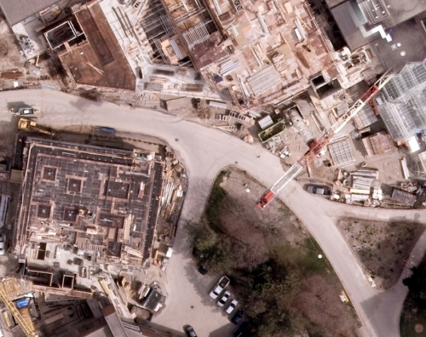

Slide 11
Spatial Data Types
Vector
• Coordinate-based (x,y)
• Points, lines, polygons
• Each point / line / polygon contains data
Example: Hospital with number of beds / doctors.

Slide 12
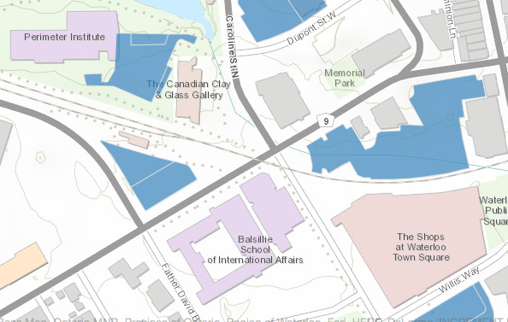

Slide 13
File types
Today, we’ll be dealing with shapefiles (.shp) and comma-separated values (.csv).
Shapefiles store geographic data.
Comma-separated value files stores tabular data.

Slide 15
GIS: Getting Started
Create a folder (\Desktop)
This is where we will store our files today.

Slide 16
Waterloo Region Census Tracts
Download Census Tract shapefile. On USB key.

Slide 17
Waterloo Region Census Tracts
Or Google Search:
‘Census Canada Shapefile 2006’ > 2006 Census geographic boundary files
Census Tracts > Download > Cartographic boundary files > ArcInfo

Slide 18
Waterloo Region Census Tracts
Unzip boundary file
In ArcMap:
File > Add data > Select boundary file

Slide 19
Waterloo Region Census Tracts
Right-click shapefile > Attribute table > Query > Select CMAUID = 541
Right-click shapefile > Save as [selected] > (/Desktop…)
That’s Kitchener CMA.

Slide 20
Waterloo Region Census Tracts
Add shapefile to ArcGIS:
File > Add data > …
Examine properties:
Right-click shapefile > Properties
Examine attribute table:
Right-click shapefile > Attribute Table

Slide 21
Income Data
Canadian Census Analyzer:
UWaterloo Library > Find & Use Resources > Statistics & Numerical Data > Canadian Census Analyzer

Slide 22
Income Data
We want 2006 Median Income for Census Tracts in Waterloo Region.
Census Tract > 2006 (Cumulative) > Income and Earnings > Kitchener > Median Income ($)
Include CTUID > Download to a file > CSV > Submit Query

Slide 23
Income Data
Download _data.csv and _header.txt to (/Desktop/...)
Open in Excel and rename columns according to _header.txt
Delete CTUID = 0 (this is average for CMA)
We need to alter CTUID to have 2 decimal places:
Right-click column > Format Cells > Number > 2 decimals

Slide 24
Income Data
Add to GIS:
File > Add Data > ...
Investigate income data:
Right-click .csv > Attribute Table
What column is shared between income data and shapefile?

Slide 25
Joining Data
We need to join the shapefile and income so we can map income.
Right-click shapefile > Properties > Join
Join based on CTUID > Check Join

Slide 26
Joining Data
Check that the join worked:
Right-click shapefile > Attribute Table
Is median income there?

Slide 27
Mapping Median Income
Now we want to map median income:
Right-click shapefile > Properties > Symbology
Select Attribute to Map (Median Income)
Select breakpoints
Select colour scheme

Slide 28
Get Data: Transit Routes
Waterloo Region Open Data:
http://www.regionofwaterloo.ca/en/regionalgovernment/OpenDataHome.asp
Download data:
Transit – GRT Routes > .shp

Slide 29
Transit Route Data
Add transit data to GIS
Open properties and check projection
Open attribute table

Slide 30
Interactive Map Data - Table
Map Data -> Table
Select tool > click on route (on map)> Open attribute table
Table -> Map Data
Click row in attribute table > view map data

Slide 31
Creating a map
Layout View is used to create final map products.
Supplement data with north arrows, legends, scales.
Add text, lines, description, etc.

Slide 32
Creating a map
Bottom left corner > Layout View
Add North Arrow
Add Legend
Add Scalebar
To edit data (colour scheme) go back to Data View

